Slide 1
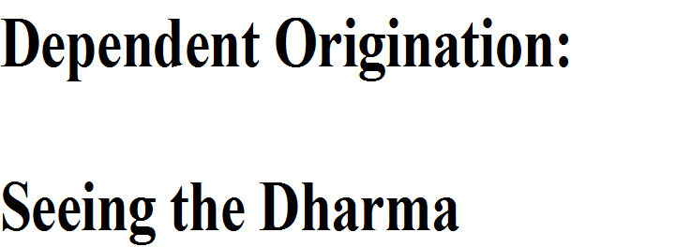

Slide 2
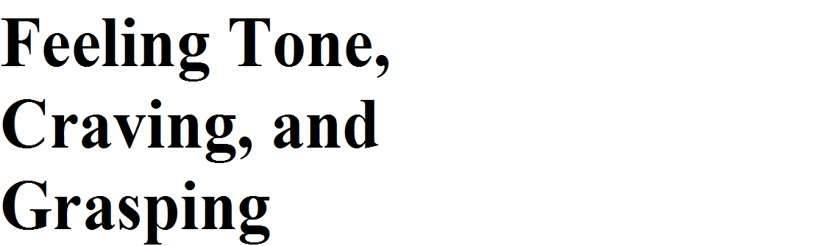

Slide 3
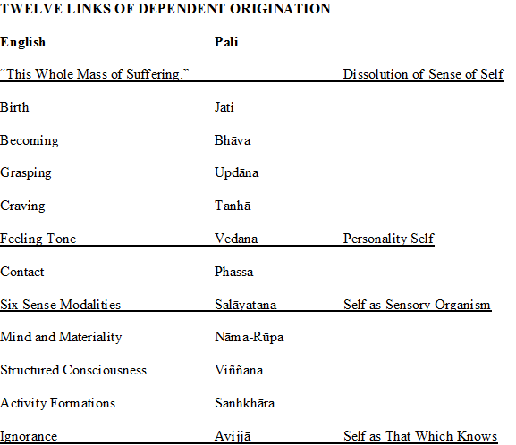

Slide 4
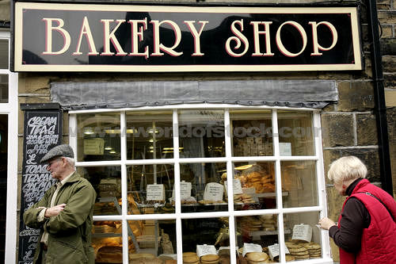

Slide 5
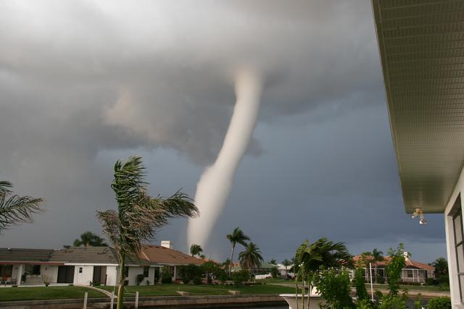

Slide 6
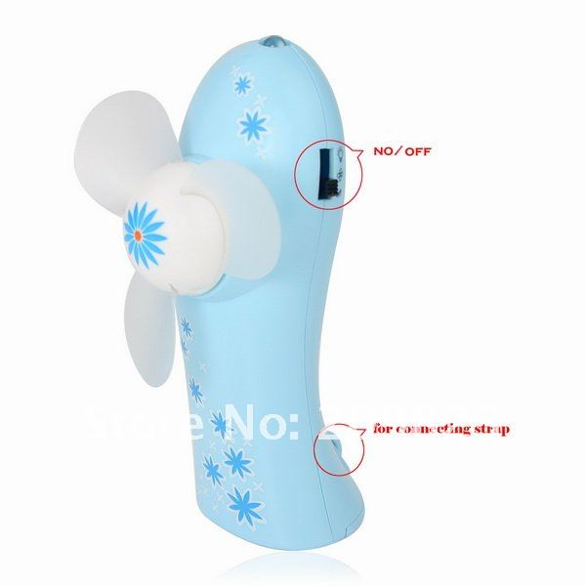
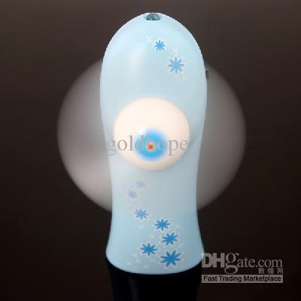

Slide 7
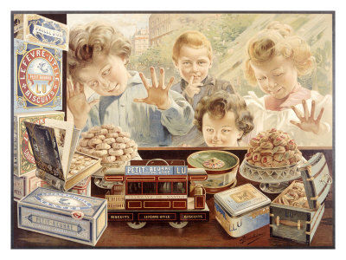

Slide 8
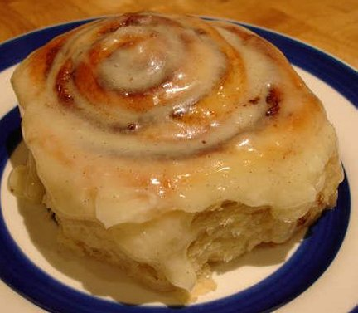

Slide 9
Dependent on Guarding of Possessions, the Taking up of Stick and Sword, Quarrels, Disputes, Arguments, Strife, Abuse, Lying, and Other Unskillful States arise.
Dependent on Avarice, the Guarding of Possessions arises.
Dependent on Possessiveness, Avarice arises.
Dependent on Attachment, Possessiveness arises.
Dependent on Intensified Desire and Passion, Attachment arises.
Dependent on Partaking, Intensified Desire and Passion arise.
Dependent on Acquisition, Partaking arises.
Dependent on Seeking, Acquisition arises.
Dependent on Craving, Seeking arises.

Slide 10
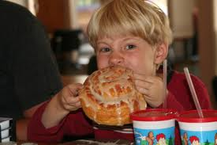

Slide 11
Dependent on Guarding of Possessions, the Taking up of Stick and Sword, Quarrels, Disputes, Arguments, Strife, Abuse, Lying, and Other Unskillful States arise.
Dependent on Avarice, the Guarding of Possessions arises.
Dependent on Possessiveness, Avarice arises.
Dependent on Attachment, Possessiveness arises.
Dependent on Intensified Desire and Passion, Attachment arises.
Dependent on Partaking, Intensified Desire and Passion arise.
Dependent on Acquisition, Partaking arises.
Dependent on Seeking, Acquisition arises.
Dependent on Craving, Seeking arises.

Slide 12
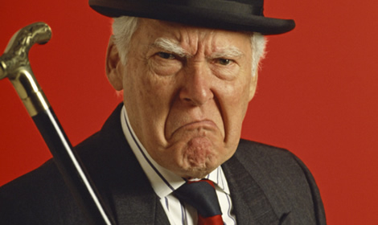

Slide 13
Dependent on Guarding of Possessions, the Taking up of Stick and Sword, Quarrels, Disputes, Arguments, Strife, Abuse, Lying, and Other Unskillful States arise.
Dependent on Avarice, the Guarding of Possessions arises.
Dependent on Possessiveness, Avarice arises.
Dependent on Attachment, Possessiveness arises.
Dependent on Intensified Desire and Passion, Attachment arises.
Dependent on Partaking, Intensified Desire and Passion arise.
Dependent on Acquisition, Partaking arises.
Dependent on Seeking, Acquisition arises.
Dependent on Craving, Seeking arises.

Slide 14
Archetypes: “unconscious universal structures, inherited blueprints, or templates, which organize psychic energy along certain repeatable and recognizable lines.”
Hester Solomon

Slide 16
Images for Practice Session

Slide 17
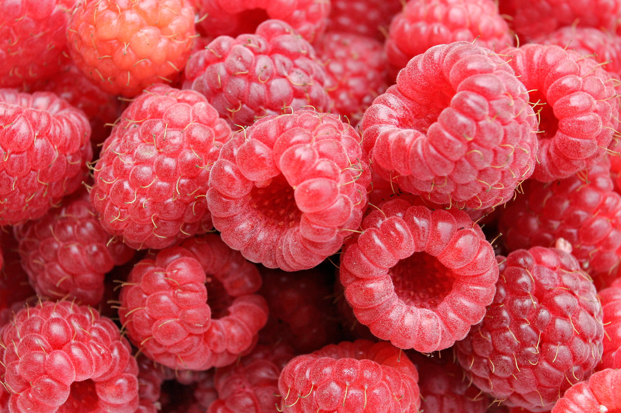
Images for Practice Session

Slide 18
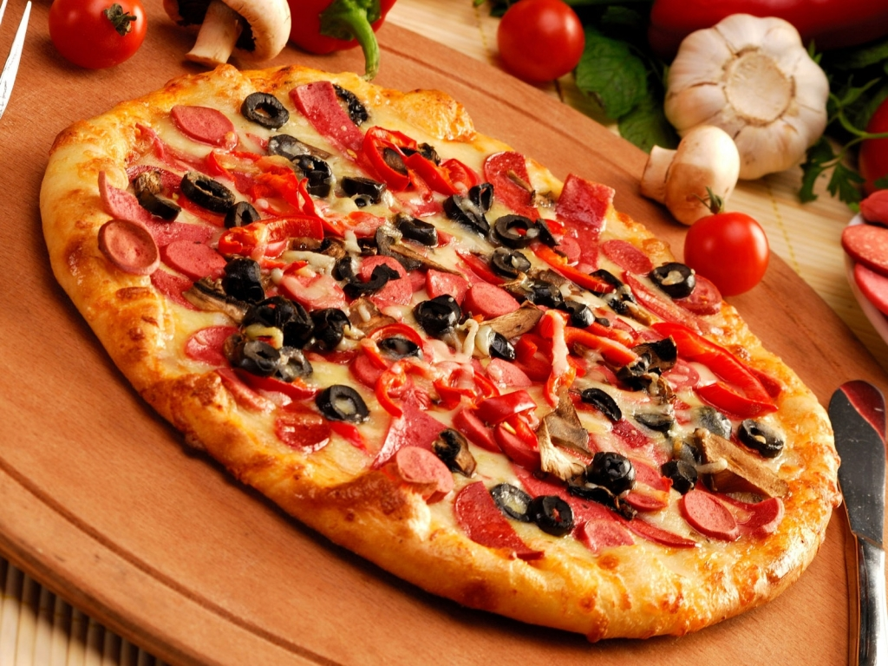

Slide 19
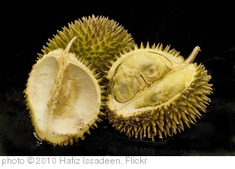

Slide 20
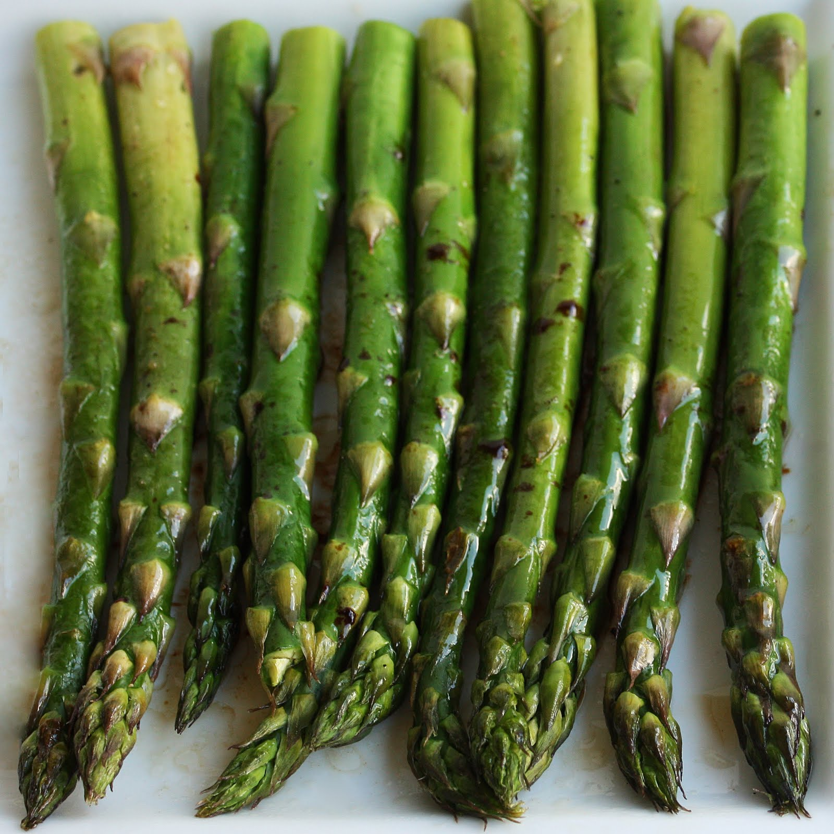

Slide 21
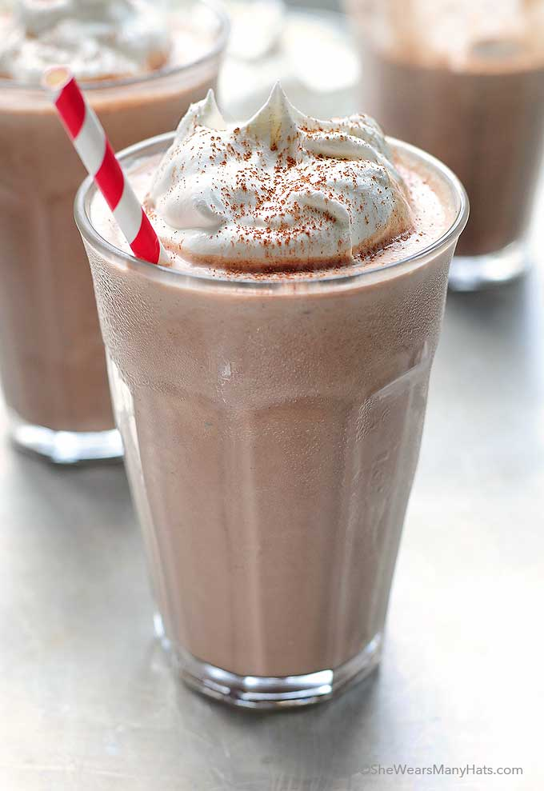

Slide 22
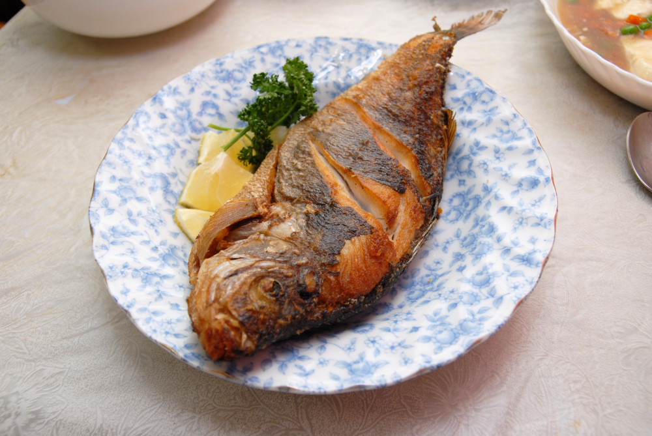

Slide 23
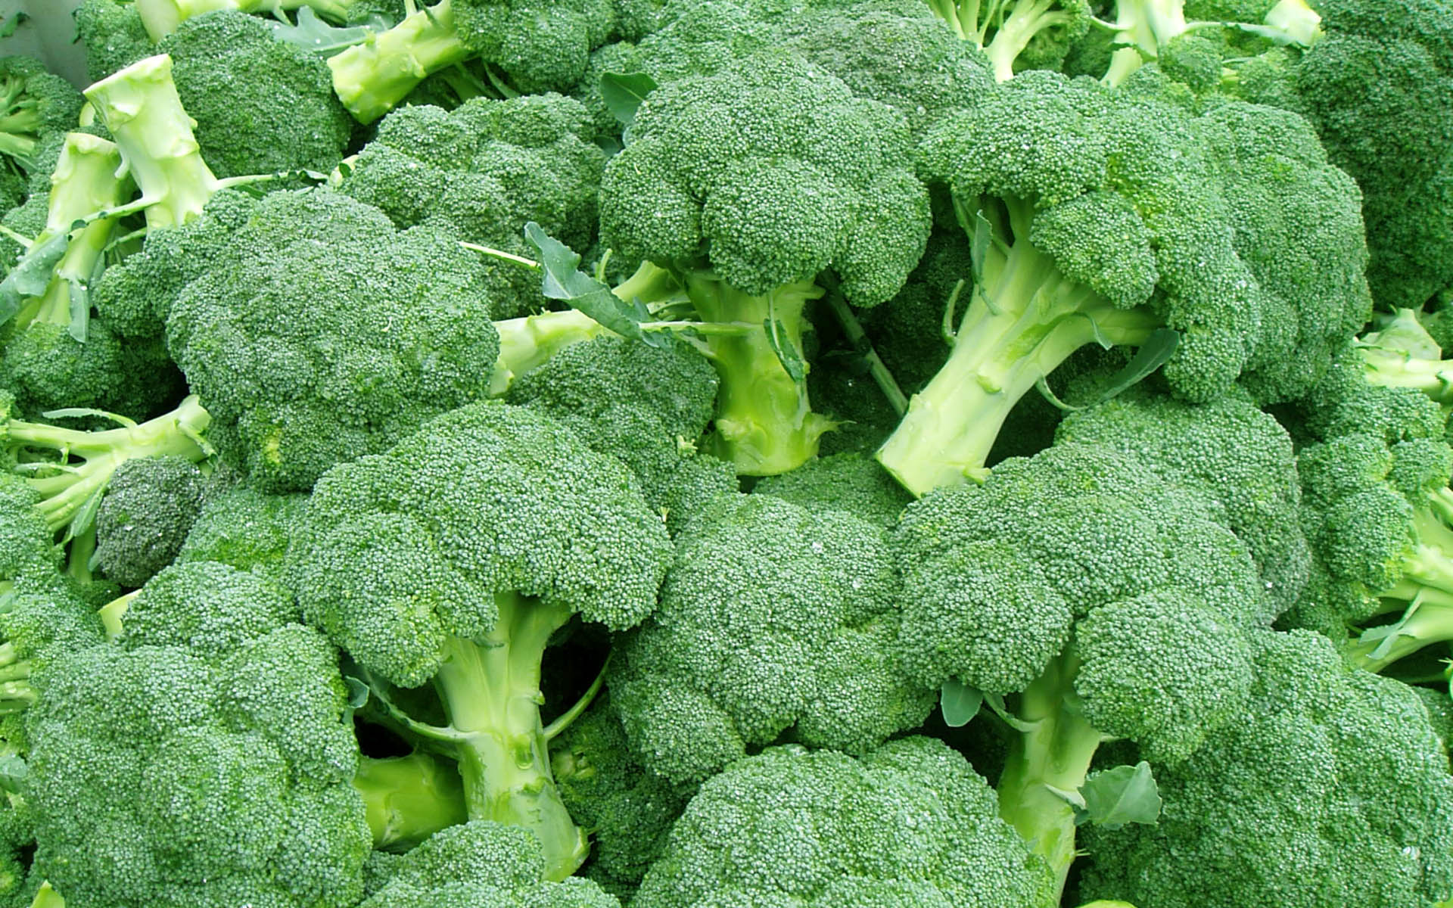

Slide 24
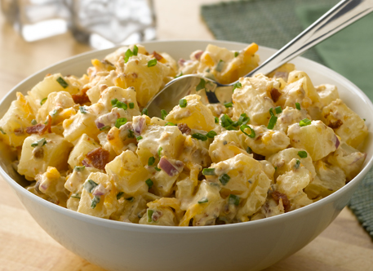

Slide 25
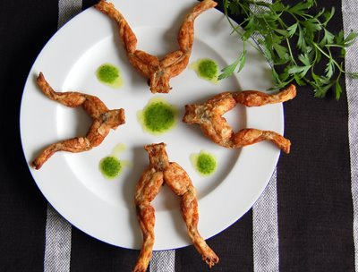

Slide 26
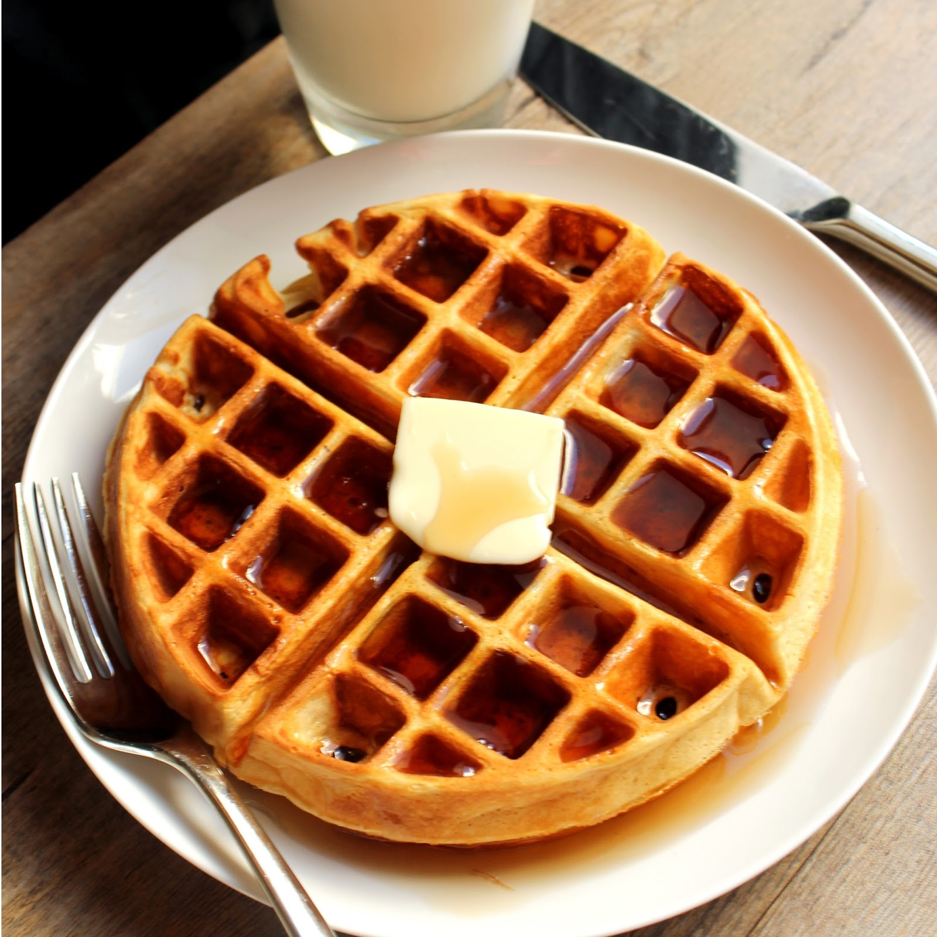

Slide 27
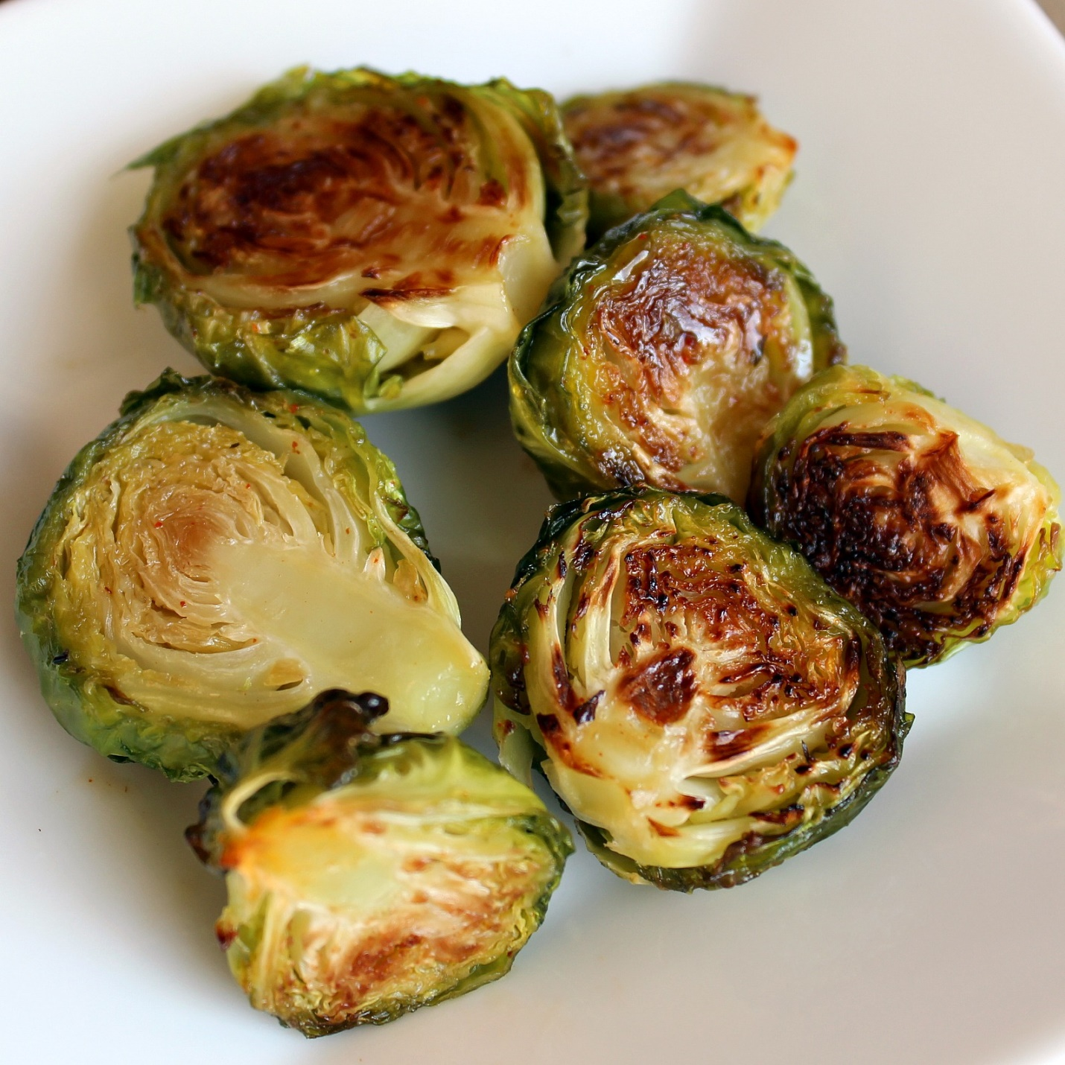

Slide 28
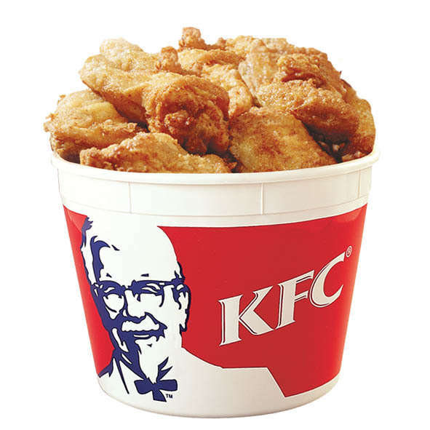

Slide 29
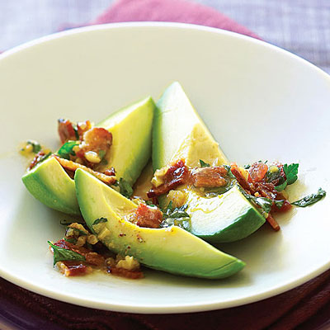

Slide 30
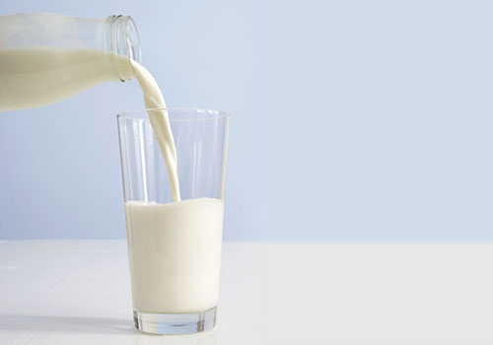

Slide 31
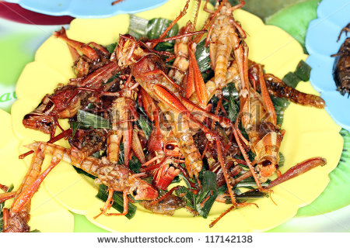

Slide 32
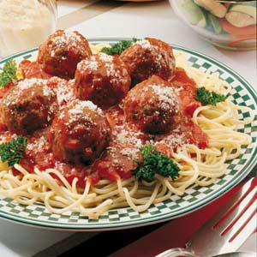

Slide 33
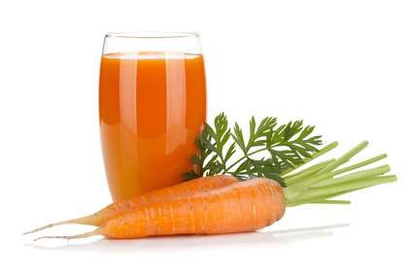

Slide 34


Slide 35
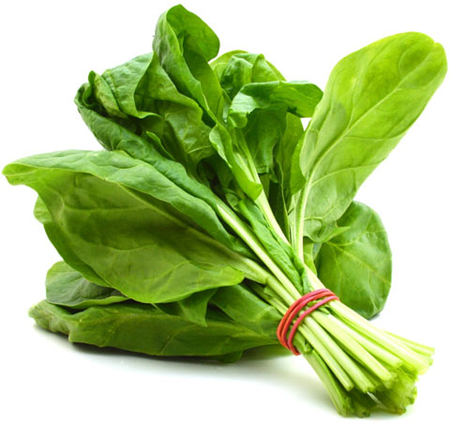

Slide 36
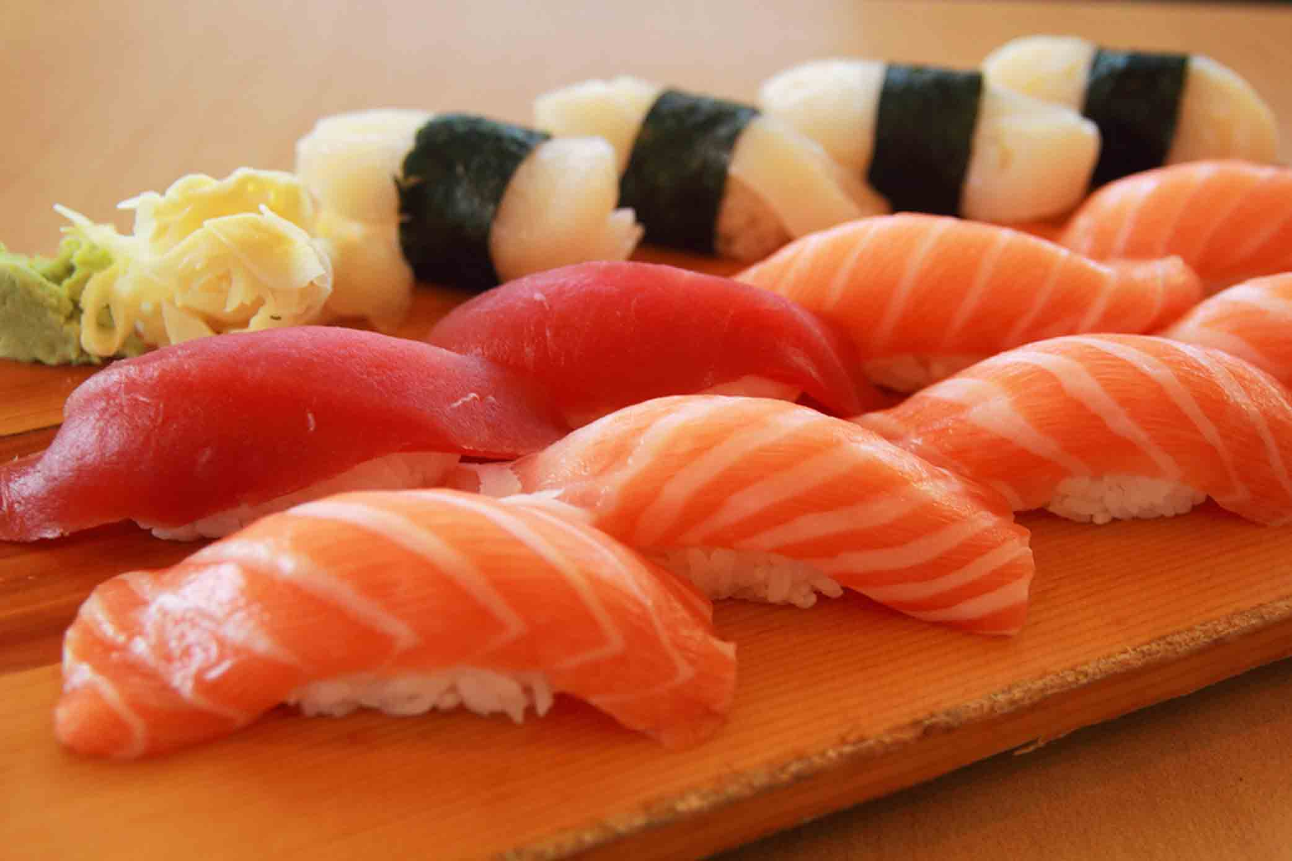

Slide 37
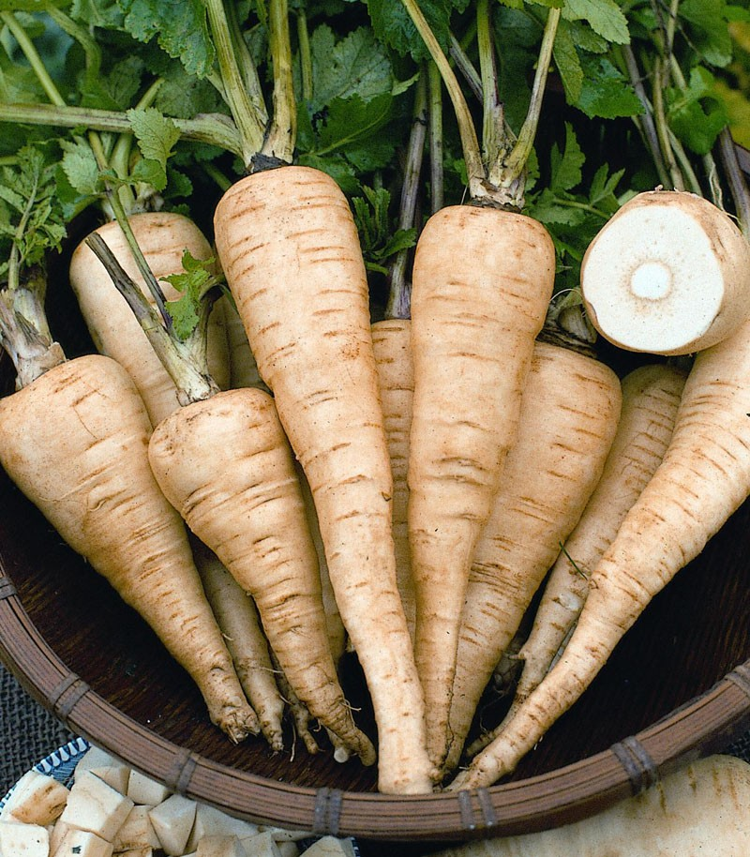

Slide 38
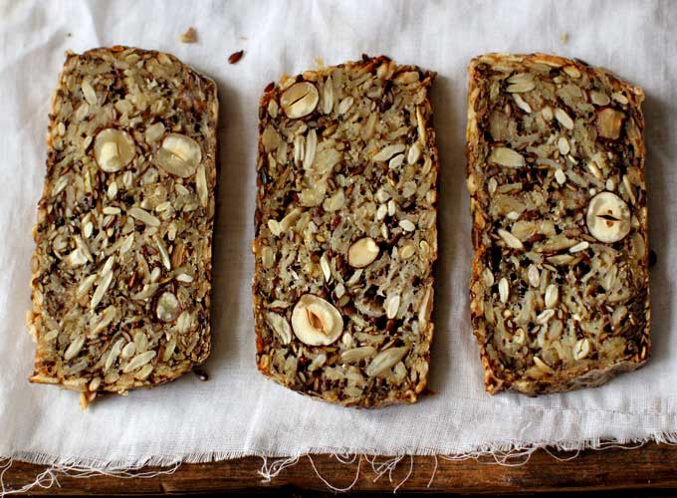

Slide 39
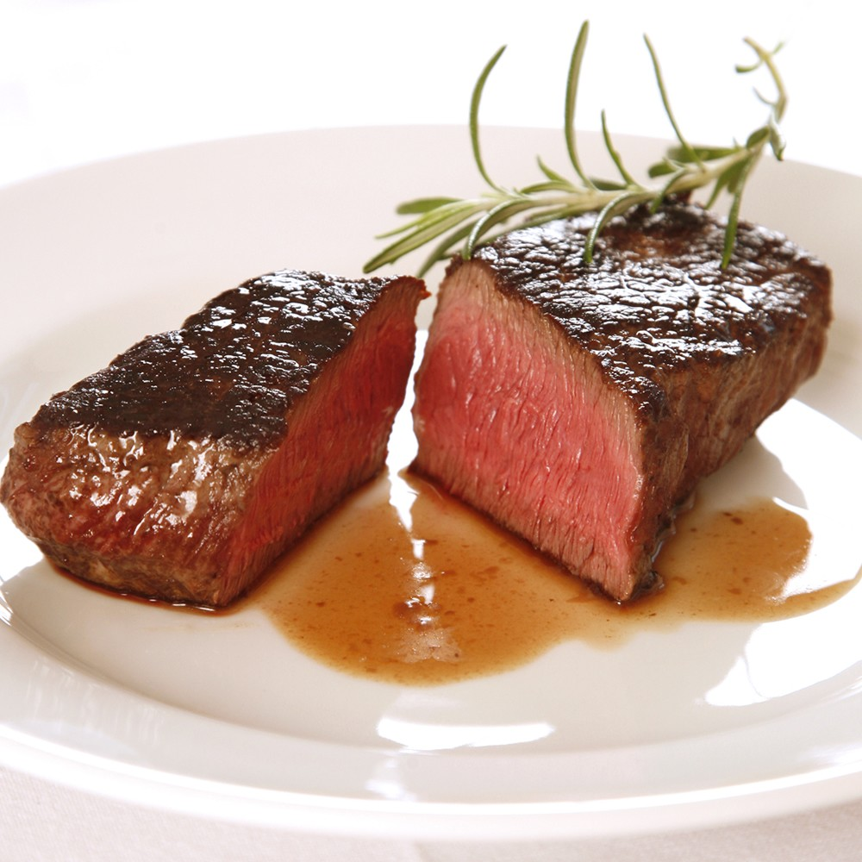

Slide 40
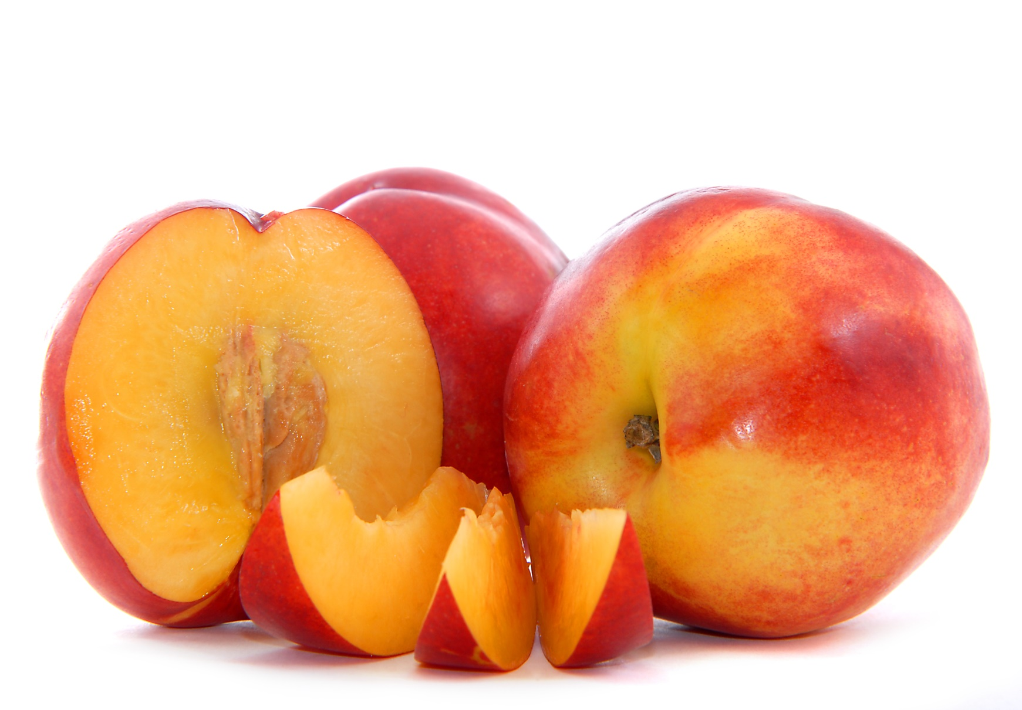

Slide 41
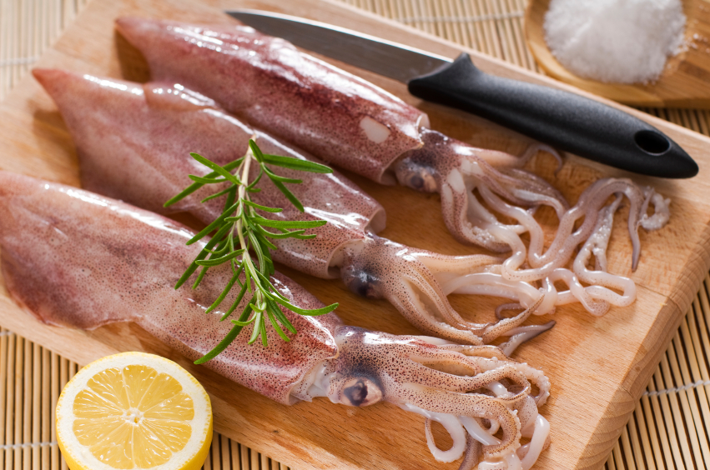

Slide 42
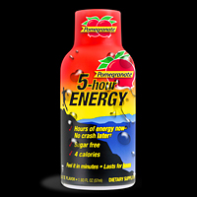

Slide 43
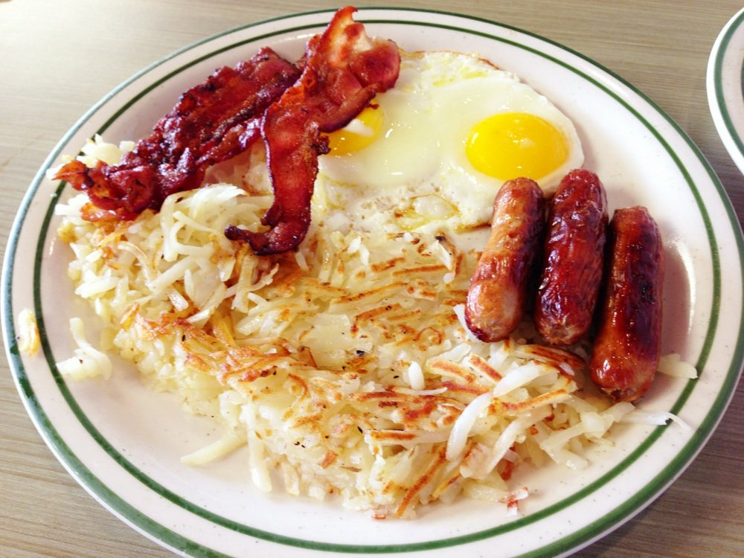

Slide 44
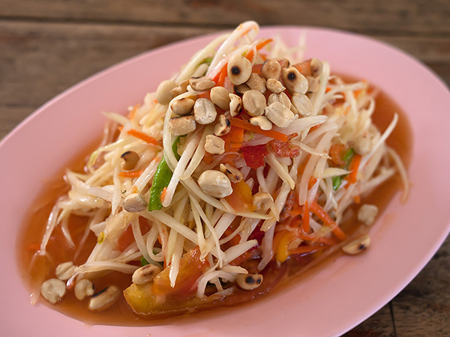

Slide 45
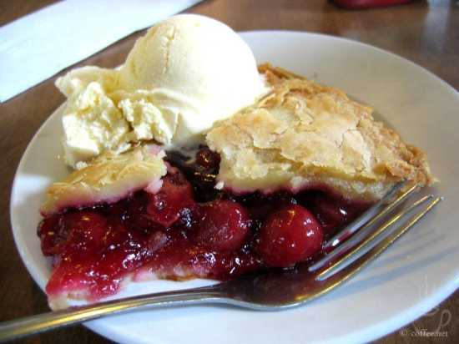

Slide 46
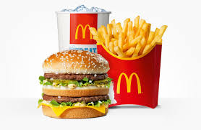

Slide 47
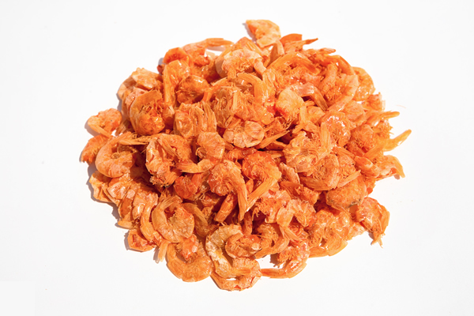

Slide 48
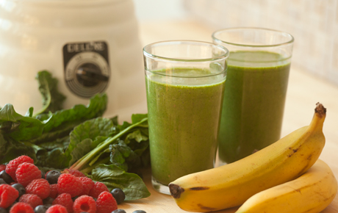

Slide 49
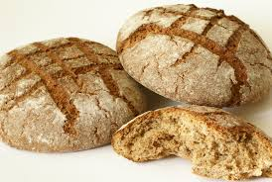

Slide 50


Slide 51
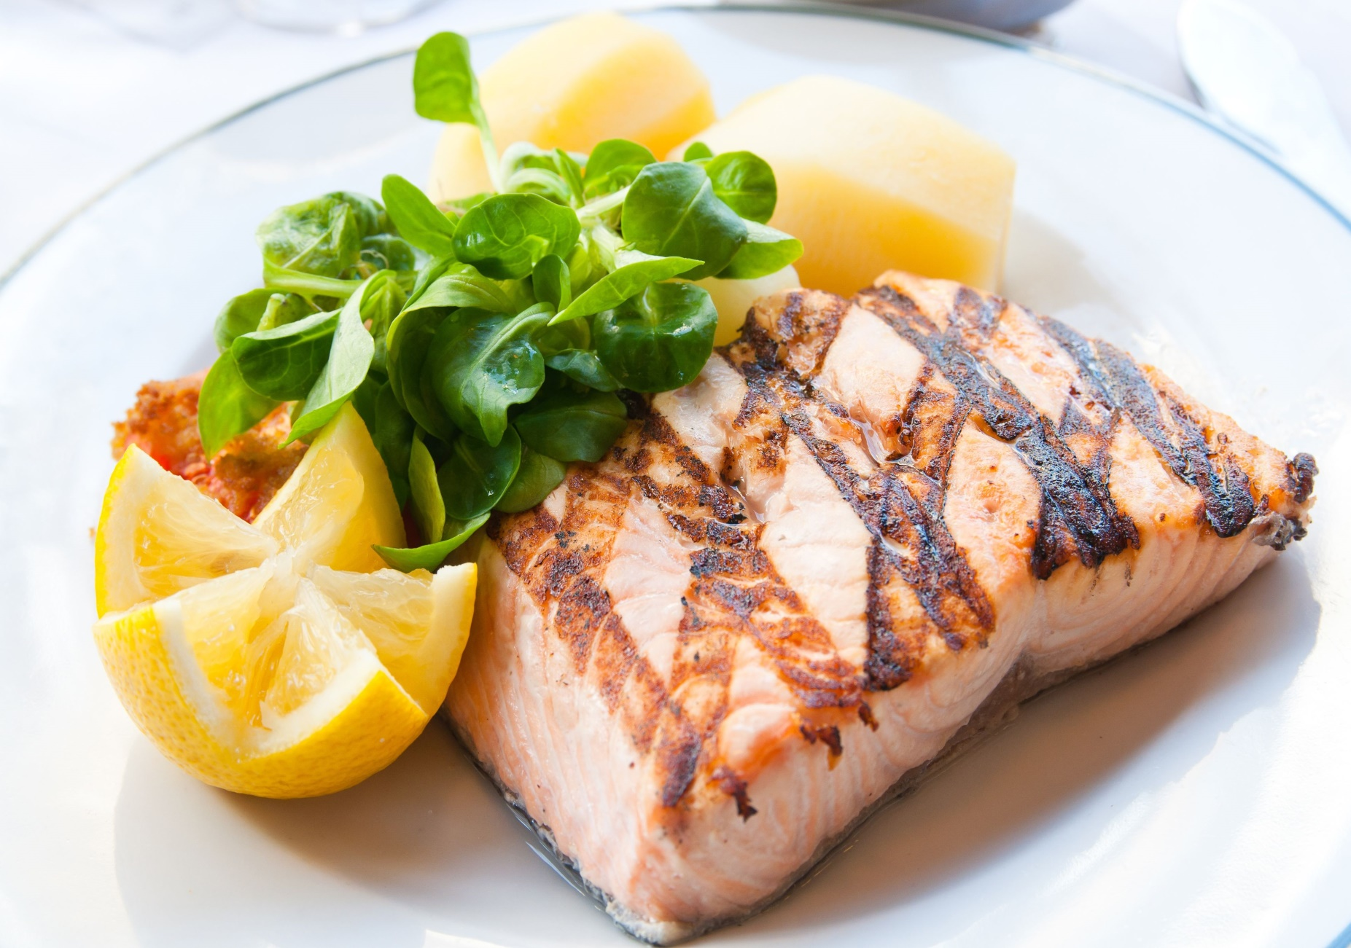

Slide 52


Slide 53
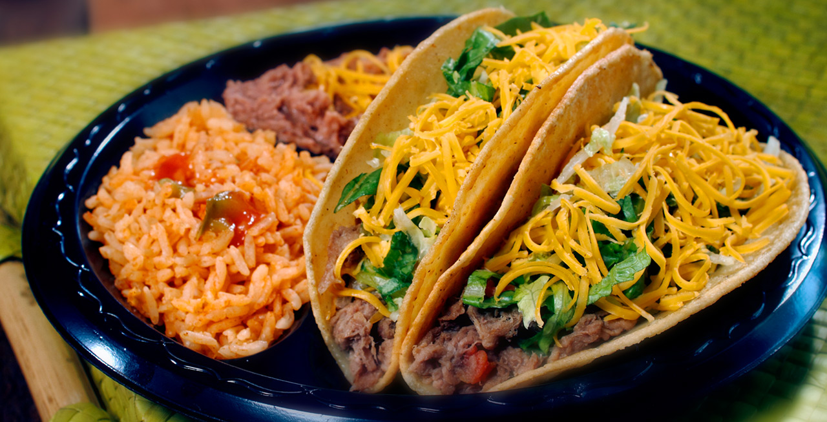

Slide 54
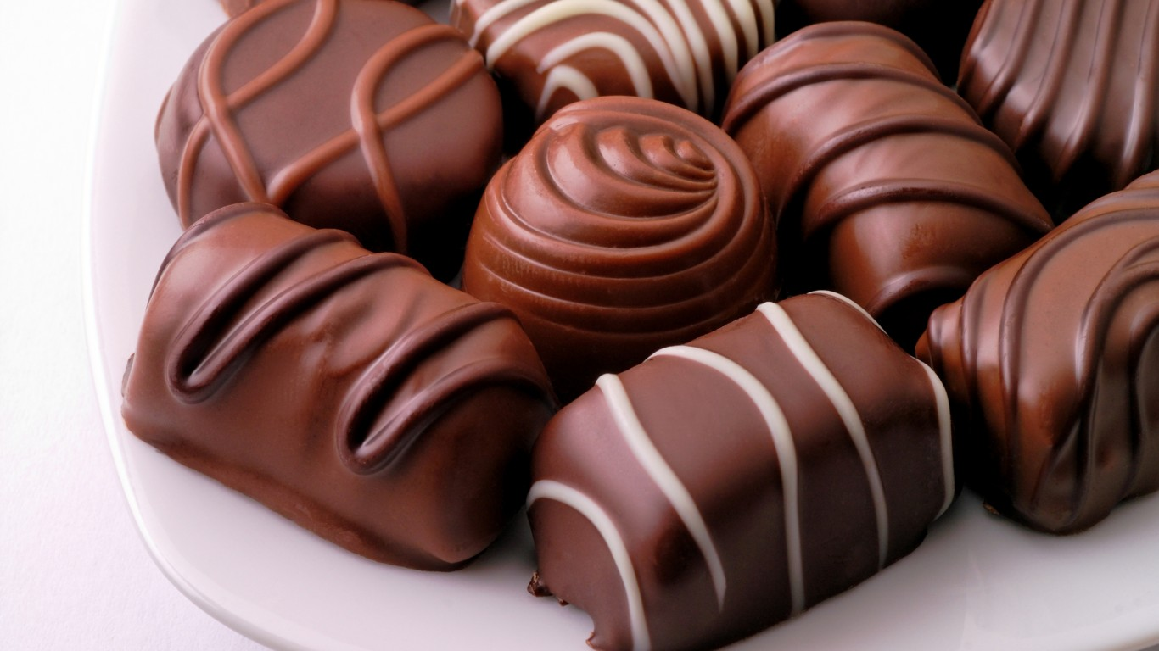

Slide 55
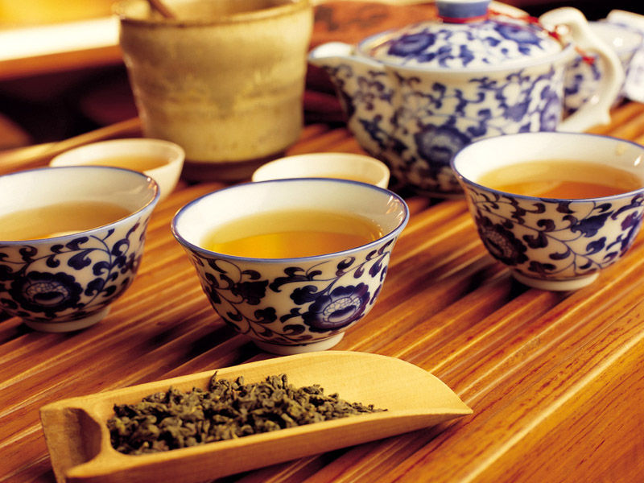

Slide 56


